Slide 1







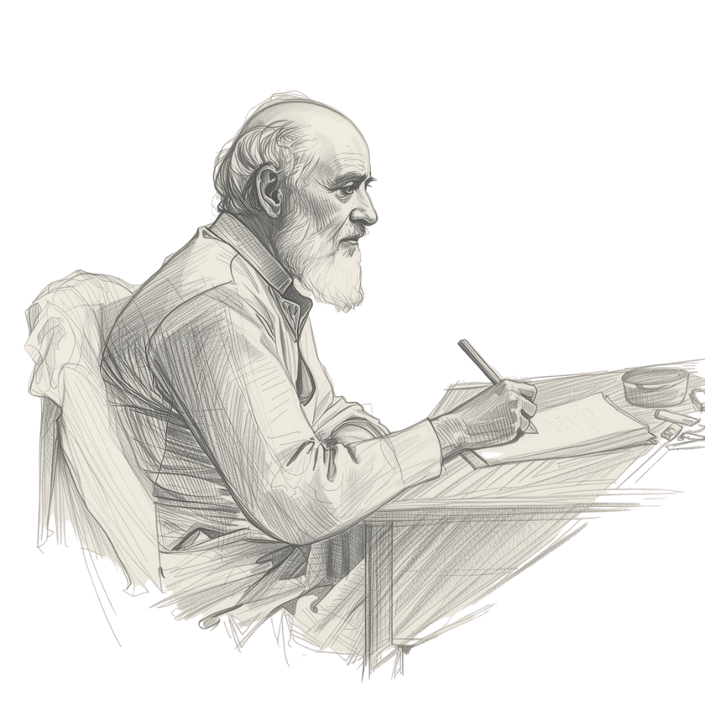

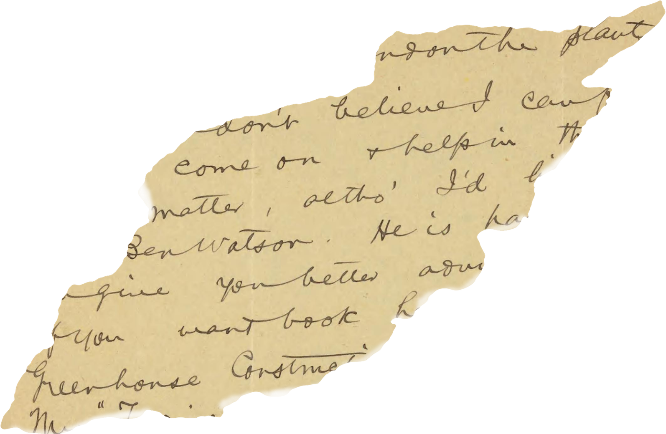


Team Four

Slide 2

Team Fourth
aavishkar singh - ra251100301024
nagulavel m - ra2511003011034
deb jyoti ghosh - ra2511003011044
anupama pandey - ra251103011054
tarannum bansal - ra251103011064
pranav pratap singh - ra2511003011084

Slide 3
About The Book
The Collection: The following stories are selected from "Selected Short Stories" by Rabindranath Tagore.
Themes: These stories explore the "small lives and small pains" of ordinary people, focusing on themes of human connection, the longing for freedom, and the emotional complexity of childhood.
Significance: Written largely during the 1890s, these narratives provide a deep reflection on social structures and the universal human spirit.

Slide 4
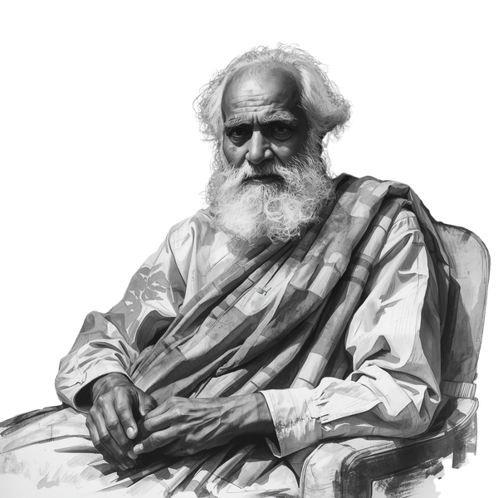
About The Author
Rabindranath Tagore
Rabindranath Tagore (1861–1941) was a monumental figure in Indian literature and the first non-European to win the Nobel Prize for Literature in 1913. A prolific poet, philosopher, and artist, he revolutionized Bengali literature and music. He founded Visva-Bharati University and composed the national anthems for both India and Bangladesh.

Slide 5
Stories
1) Kabuliwallah
2)Holiday ( chhuti)
3) guest ( atithi)

Slide 6
Kabuliwallah - Summary
The story depicts the beautiful friendship between Mini, a talkative five-year-old girl, and Rahamat, a giant fruit-seller from Kabul.
Rahamat sees his own distant daughter in Mini and brings her dry fruits to win her over.
Years later, after Rahamat is released from prison, he returns to find Mini on her wedding day.
He realizes that his own daughter must have grown up too, highlighting a shared bond of fatherhood that transcends geography and social class.

Slide 7
Kabuliwallah
Connection to the Theme
Universal Fatherhood: The story proves that parental love is a universal emotion that connects people regardless of their background.
Human Connection: It teaches that empathy can bridge the gap between different cultures and ages.

Slide 8
Holiday - Summary
Phatik Chakravorti, a mischievous boy in a village, is sent to Calcutta to live with his uncle and get an education.
In the city, he feels like an unwelcome guest, constantly criticized by his aunt and struggling in a cramped school.
Deeply homesick, Phatik yearns for the freedom of his village and the "holiday" of going home.
The story ends tragically when his ultimate "holiday"—freedom from his suffering—comes through his falling ill and passing away just as his mother arrives.

Slide 9
Holiday
Connection to the Theme
The Pain of Alienation: It shows the emotional toll that a lack of love and belonging can take on a child.
Nature vs. City: It highlights the critical need for a supportive environment that respects an individual's natural spirit.

Slide 10
Guest (Atithi) - Summary
Tarapada is a young boy with a wandering soul who runs away from his home to join various groups of performers and travelers.
He is eventually taken in by a kind zamindar’s family who treats him like a son and hopes to marry him to their daughter, Charushashi.
Despite the comfort and affection offered to him, Tarapada’s spirit remains "entirely detached and free".
In the end, he leaves the family and their settled life behind, choosing his freedom and the call of the open road over domestic security.

Slide 11
Guest (Atithi)
Connection to the Theme
The Spirit of Freedom: The story explores the idea that true fulfillment for some comes from independence rather than social expectations.
Defining Identity: It teaches that an individual’s true nature cannot be confined by the desires of others, even when those desires are well-intentioned.

Slide 12
Connection to SDG’s
SDG 10 : Reduced Inequalities:
Literary Connection: These stories reflect the need to treat every person—whether a foreign fruit-seller like Rahamat or a displaced boy like Phatik—with respect and dignity.
Example: In Kabuliwallah, the narrator eventually recognizes the fruit-seller as a fellow father, reducing the social inequality between them through empathy.

Slide 13
Connection to SDG’s
SDG 16: Peace , Justice & Strong Institutions
Literary Connection: Literature showcases the human aspect of ethics and the importance of inclusive societies.
Example: Holiday highlights the failure of domestic and educational "institutions" (the school and the uncle's home) to provide a safe, inclusive environment for a child, leading to a tragic outcome.

Slide 14
Thank You
Presented By : TEAM FOUR.

